Slide 1
City of Little Rock Mental Health Support Resources
SWEAP Connections
SWEAP Connections - Solutions for Life and Work. Sometimes balancing work and family responsibilities can be stressful. Your Employee Assistance Program (EAP) offers a confidential service designed to help employees and families with personal and/or work related problems. You are provided up to eight (8) sessions per issue, per year at no cost to you. You can call 1-800-777-1797 or go online and login https://sweapconnections.com/for-employees/ using the password SWEAP.
Cigna
You can find information on the following at www.MyCigna.com
MyCigna.com – Log on to www.MyCigna.com using your medical ID number and personal information. From the home page click on Wellness. From there click on Mental Health Support. You will be prompted to a screen to begin you process to speak with a therapist
Behavioral Health Virtual Visits – 1:1 Emotional Support. With virtual therapy getting help may now be easier than ever. Get connected one-on-one, by phone, with professionally trained behavioral health experts, at no additional cost to you. Call the number on the back of your medical ID card or 1-866-633-2446. Services are subject to the same co-pay or co-insurance rate (after deductible) that would apply to an in-person visit.

Slide 2
City of Little Rock Mental Health Support Resources
Cigna
You can find information on the following at www.MyCigna.com
Substance Use Treatment Helpline at 1-855-780-5955, 24 hours a day to speak with a substance use recovery advocate who will listen, provide support and develop personalized recovery plans. Call the number above or visit www.liveandworkwell.com/recovery to find care options and resources.
The Suicide Prevention Hotline – 1-800-273-8255
National Domestic Violence Hotline – 1-800-799-7233
Employee Assistance Program (EAP) – Your Employee Assistance Program (EAP) is here to help you, and your family, get the most out of life. We're ready to help with the small questions and the big problems, and everything in-between, such as: Managing stress; Improving relationships at home or work; Addressing legal and financial concerns; Getting the most out of your career; Finding child development, childcare or elder care resources; Getting past emotional issues or grief; Addressing depression, anxiety or substance use issues; This service is confidential and our EAP Specialists are available 24/7. They can provide you immediate help or direct you to one of our network providers for no-cost, face-to-face consultations. Log into www.MyCigna.com. From there click on Coverage and scroll down to Employee Assistance Program.

Slide 3
City of Little Rock Mental Health Support Resources
Cigna
You can find information on the following at www.MyCigna.com
Legal Services - Access to advice, help drafting a will or assistance with a complicated legal matter should not be out of anyone’s reach. Your Employee Assistance Program provides legal assistance services that give you free and discounted confidential access to local attorneys to answer legal questions, prepare legal documents and help you resolve legal issues. Access to legal assistance services includes: Access to licensed state-specific attorneys; One 30-minute telephonic or face-to-face consultation per issue per year at no cost to you*; Ongoing representation by an attorney at a 25% discounted rate. Call 1-866-374-6060
Financial Services - Individuals may receive 30-60 minutes of telephonic consultations per issue, per year with an experienced, credentialed financial coach to address a wide array of concerns. Call the support number to receive consultation on issues such as: Budget management; College funding; Debt reduction; 401K, IRA, HSA questions; Estate planning; Bankruptcy; Investment plans; Retirement planning; Taxes; and Wage garnishment. Call 1-866-374-6060
Omada Health – Half of healthcare is care. Our virtual-first, integrated care programs help people make lasting health changes that truly change their lives. That's why organizations choose our data-driven care solutions to drive lower costs and better outcomes. Omada aims to inspire people to make lasting health changes on their own terms. We partner with health plans and employers to equip members with personalized tools, resources, and support to improve their health one step at a time. Sign up for Omada at www.MyCigna.com.
*Some exceptions apply

Slide 4
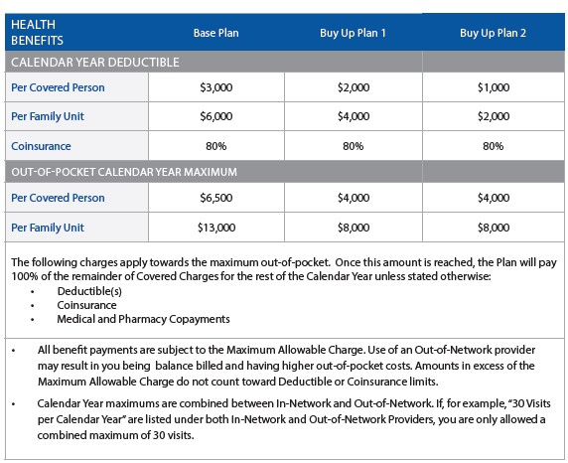
City of Little Rock Mental Health Support Resources
Cigna
You can find information on the following at www.MyCigna.com
Deductible and Applicable Co-pays for Mental Health and Substance Use services

Slide 5
Thursdays: 7:30 PM Central Time Call-in number: 844.621.3956
Passcode: 965 38 022
Add to calendar
week, every week. Join us for a 30-minute session by telephone:
Tuesdays: 4:00 PM Central Time Call-in number: 844.621.3956
Passcode: 965 38 022
City of Little Rock Mental Health Support Resources
Cigna
Practice mindfulness using these Cigna resources.
With your Cigna plan, you can access a number of mindfulness tools at no cost to you.
The Changing Lives by Integrating Mind and Body® (CLIMB) program:
At cigna.com/CLIMB, you can find free podcasts that help incorporate mindfulness into your daily life, including:
    Mindful Breathing
    Basic Guided Mindfulness Meditation
    Meditation and Body Scan
    Working with Difficulties and Cultivating the Positive
    Managing Stress
    Compassion and Self-Care
Live guided sessions are available twice a week, every week.
Join us for a 30-minute session by telephone:
Tuesdays: 4:00 PM Central Time Call-in number: 844.621.3956
Passcode: 965 38 022
Add to calendar

Slide 6
City of Little Rock Mental Health Support Resources
Cigna
Connect with HappifyTM.
Happify is an app that uses science-based activities and games to help reduce stress, increase mindfulness and improve emotional well-being.
Use Happify’s Mindfulness tracks to help develop your daily practice
Learn evidence-based techniques developed by leading scientists and experts
Access the app 24/7 using your phone, tablet or computer
Go to mycigna.com to get started. Or visit happify.com/cigna.

Slide 7
City of Little Rock Mental Health Support Resources
Lincoln Financial
You can find information on the following at www.lincolnfinancial.com
EmployeeConnect – Everyone needs help solving problems. EmployeeConnect offers confidential assistance to help you and your family meet the challenges that life, work and relationships can bring. You and your immediate household family members are eligible to access EmployeeConnect services as part of your long-term disability coverage from Lincoln. Contact Lincoln Financial at 1-888-682-4824 for more information.
What services can you access?
In-person help for short-term issues; up to four* sessions with a counselor per person, per issue, per year
In-person consultations with network lawyers, including one free 30-minute in-person consultation per legal issue, and subsequent meetings at a reduced fee
Get Help 24/7 – Unlimited toll-free phone and online access to:
  Family and personal convenience information and referrals for topics such as child and elder care, kennels and pet care, vacation planning, relocation, car buying and colleges
  Legal information and referrals for situations requiring expertise in family law, estate planning, landlord/tenant relations, consumer and civil law and more.
  Financial information and referrals to assist with concerns such as household budgeting, as well as short and long-term planning.
  Call 1-888-682-4824
  Online: www.guidanceresources.com
  (user name = LFGsupport; password = LFGsupport1

